Slide 1
Blood bank application

Slide 2
Introduction
All living organisms must always have blood on hand in case of need. There are many electronic blood donation centres to help in communication between blood donors and medical establishments. There are no online blood donation services that allow for direct communication with the recipient. This is the system’s true flaw at the moment. The current frameworks need a lot of time, money, and labour. The innovative concepts could improve blood banks that already exist and facilitate the shift from traditional desktop to portable architecture. The remainder of the proposed study addresses various aspects of the elements of the improved framework, such as the data being kept, data for future applications, and the various blood group kinds being given and received.

Slide 3
Motivation
Our blood bank application makes the process of reaching out to potential blood donors easy and encourages people to become voluntary donors. Blood Donors can see their influence and create blood donation awareness to save multiple lives.

Slide 4
Problem Definition
The problem definition of the system is to launch an online interaction medium for the blood donation management. 2The main aim of this project is to help the people who needs blood in emergency and to associate some donors who are willing to donate their blood to needy people and save their lives.

Slide 5
Literature Survey
• 1.Paper Name: blood bank information system using android application Author: Neetu Mittal, Karan Snotra Amity University Uttar Pradesh, Noida College Of Engineering For INFORMATION TECHNOLOGY 2022-23 2 nmittal1
Abstract :- Availability of blood during emergencies is highly critical for every single living thing. There are number of electronic blood donation centers for effective communication between them and medical facilities. None of the online blood donation center offers the immediate contact amongst beneficiary and them. This is the real downside of the current framework. The existing frameworks are tedious; require more labor and expensive. This paper presents a correlation between existing blood bank framework and enhanced framework to improve the effectiveness.

Slide 6
2.Paper Name:Blood Bank App using Raspberry PI Author:Surabhi Pohandulkar, Chhaya 6Khandelwal
Abstract :- The paper “Blood bank application using raspberi pi” proposed to bring near blood bank and the person who need the blood due to accident or any emergency. Our aim to propose this paper is to reduce the time span between the donor and recipient. By using Raspberry pi 2 and GSM modem SIM900A, we collect all the data base from blood bank and fetch the given data as per request from recipient. The fetched blood donor data is sent to the recipient and also with addition an IP Address is attached to the message which allows the recipient to download an app and get all the information. The vision of this paper is “To provide a better service of every person who is in search of blood College Of Engineering For INFORMATION TECHNOLOGY 2022-23 4

Slide 7
3.Paper Name:Intelligent Blood Management System
Author:Mitesh Sarode, Ayush Ghanekar, Sahil Krishnadas, Yash Patil, Manish Parmar
Abstract :-This paper presents an efficient method for a smart blood management system, called Intelligent Blood Management System (IBMS) that intends to provide a efficient and a real time coordination of blood management within a blood bank as well as to establish great communication amongst multiple blood banks. This system uses an unique and a economical concept of using the weight detecting sensors along with image processing that can efficiently track the quantity of the different blood groups (using colour coding mechanism) in all the associated blood banks, using Cloud connectivity.

Slide 8
4.Paper Name:-Computerized Central Blood Bank Management System (CCBBMS)
Author : Mohammed Y. Esmail,Yousra Sayed Hammad Osman .
Abstract:- Blood is a vital constituent in human body that is indispensable for human life, it supplies nutrient and oxygen to all body cells, because of this essential role, blood bank was introduced in this paper. Manual systems as compared to computerized systems are time consuming, costly, and human errors. A computerized central blood bank management system was developed to assist in managing donor records, monitoring blood screening and storing, moreover provide secure medical reports to improve medical service delivery. The system was designed and implemented as a web-based using My SQL data base, PHP programming language and a bar-code technique. The outcome was obtained as screens that made the recording process of donor’s data and blood easer so as to ensure the efficiency of transfusion process. The system was tested in the National Blood Transfusion Center NBTC of Khartoum-Sudan, it contributed to solve errors of manual system, time consuming and retrieve data, as well as met users’ acceptance. College Of Engineering For INFORMATION TECHNOLOGY 2022-23 6

Slide 9
5.Paper Name:A Secure Cloud Computing Based Framework for the Blood bank.
Author:Mr. Shreyas Anil Chaudhari,Ms. Shrutika Subhash WalekarMs. Khushboo Ashok Ruparel,Ms. Vrushali Milind Pandagale
Abstract:.A blood Bank can be defined as a bank or storage place where blood is collected, preserved and used whenever needed or demanded. Everyone is aware that the traditional blood bank management system includes paperwork. Its way of working is not efficient enough at the time of emergency situations. The main aim of creating cloud-based blood bank system is to make the blood available on time to the people, even in emergency situations. With the help of this project, the user can be able to view information about every entity related to blood bank i.e. hospitals, donors, a location of another blood bank etc. The security factor is maintained properly. Every time the new user accesses the system as a donor, he/she has to register himself/herself and provide a proof of their identity like license or government document on which the blood group of the person is mentioned.

Slide 10
Hardware Requirements Specification
Hardware : intel core
Speed : 2.80 GHz
RAM : 8GB
HardDisk : 40 GB
Key Board: Standard Windows Keyboard

Slide 11
Project Scope
Scope is an individual that involve in some module in this project.The quality and accuracy will be maintained in a proper way

Slide 12
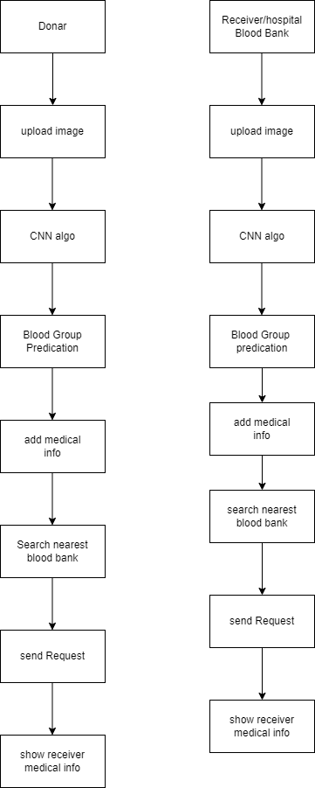
Architecture

Slide 13
Conclusion
The reliable blood bank system. Latest technology and information system plays a vital role in blood bank system and its services, as its quality improves. The system is beneficial for both requester and donor too. Due to this System, the bridge between donor and the requester is reduced and their Communication improves. Thus, providing the requested blood on time to the requester, when needed. The health sector will be definitely benefited by the services provided by the system as patients safety and life

Slide 14
Survey Paper
1. Javed Akhtar Khan and M.R. Alony, ”A New Concept of Blood Bank Management System using Cloud Computing for Rural Area,” International Journal of Electrical, Electronics ISSN No. (Online): 2277-2626 and Computer Engineering 4(1): 20- 26(2015).
2. T.Hilda Jenipha and R.Backiyalakshmi, ”Android Blood Donor Life Saving Application in Cloud Computing,” American Journal of Engineering Research (AJER) 2014.
3. Sagar Shrinivas, Vasaikar Vijay and Suresh Yennam, ”Online Blood Bank Using Cloud Computing,” International Journal of Advanced Research, Ideas and Innovation In Technology,(volume 3, Issue 1)
4. P. Priya, V. Saranya, S. Shabana and Kavitha Subramani, ”The Optimization of Blood Donor Information and Management System by Technopedia,” International Journal of Innovative Research in Science, Engineering and Technology An ISO 3297: 2007 Certified Organization, Volume 3, Special Issue 1,2014.
5. Siva Shanmuga and N. Ch. S. N. Iyengar, ”A Smart Application on CloudBased Blood Bank,” Journal of Computer and Mathematical Sciences, Vol.7 (11), 576-583, November 2016.

Slide 15
6. Almetwally M. Mostafa, Ahmed E. Youssef, “.A Framework for a Smart Social Blood Donation System based on Mobile Cloud Computing,”
7. Deepak Pandey, Achal Umare and Dr.R.S.Mangrulkar, “Requirement Based Blood Storage and Distribution System,” International Journal of Research In Science Engineering Volume: 3 Issue: 2 MarchApril 2017
8. Arif. M. Sreevas. S. Nafseer. K. And Rahul . R. (2012), ‘Automated online Blood bank Database’, India Conference (INDICON), Annual IEEE, Print ISBN:978-1-4673-2270-6, PP.012-017
9. The Optimization of Blood Donor Information and Management System by Technopedia, IJIRSET, An ISO 3297: 2007 Certified Organization, Volume 3, Special Issue 1, ISSN (Online) : 2319 –8753 February 2014
10. Abhijeet Gaikwad, Nilofar Mulla, Tejashri Wagaj, Raviraj Ingale, Prof. Bijendra Gupta and Prof. Kamal Reddy “Smart Blood Finder”, International Journal of Trend in Scientific Research and Development (IJTSRD), Nov-Dec 2018.

